Slide 1
Iowa Liquor Sales (2018-2023)
File created on: 8/18/2023 6:53:04 PM

Slide 2
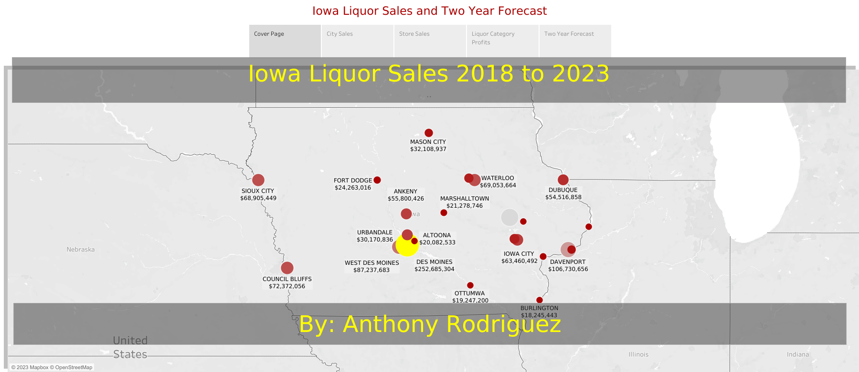

Slide 3
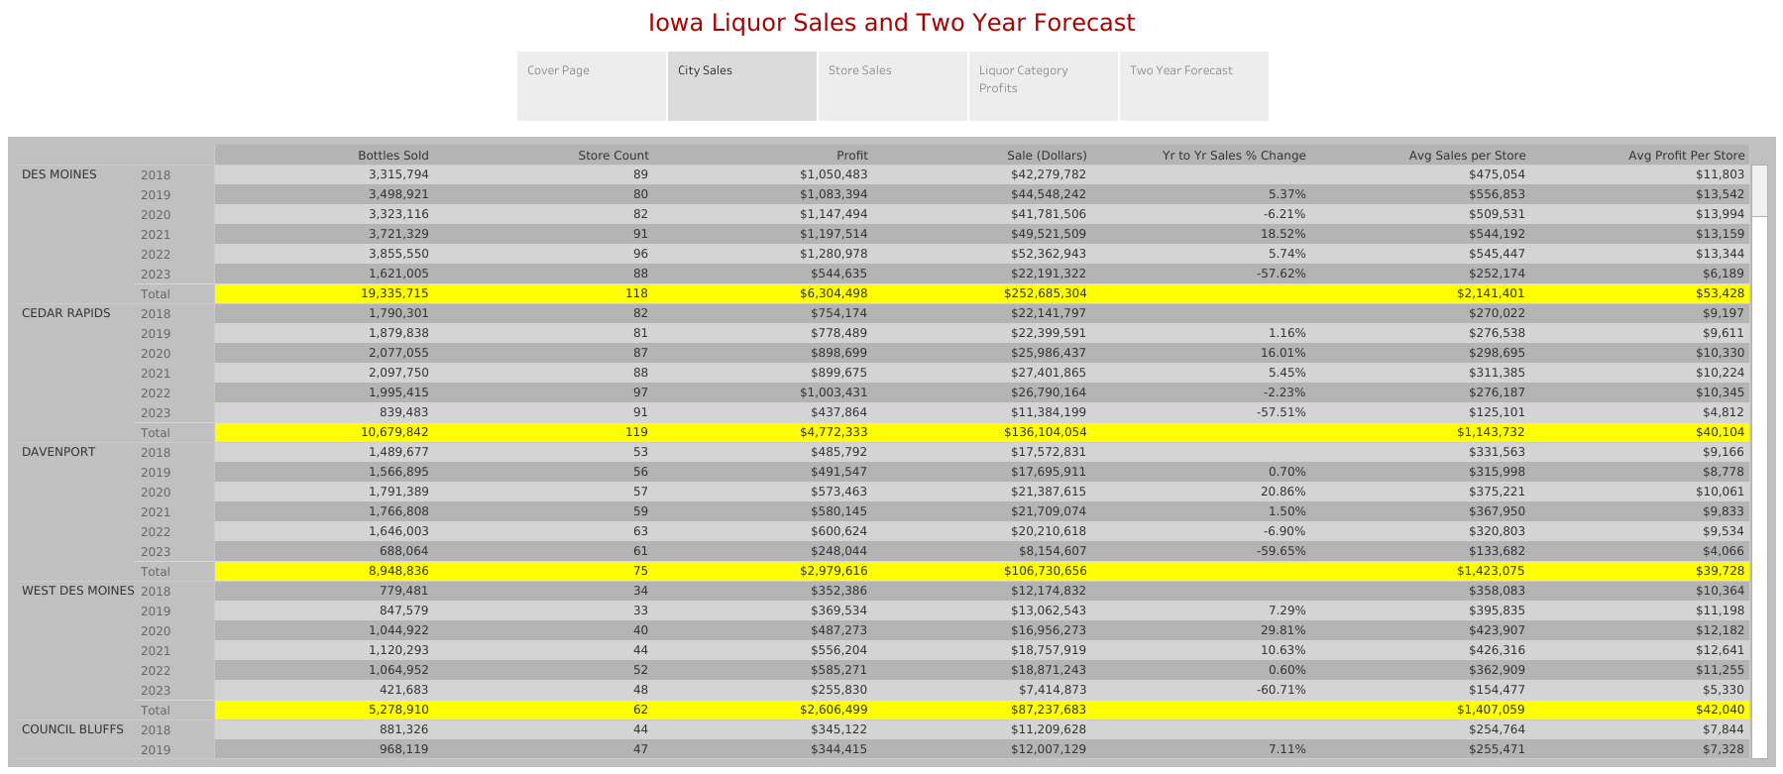

Slide 4
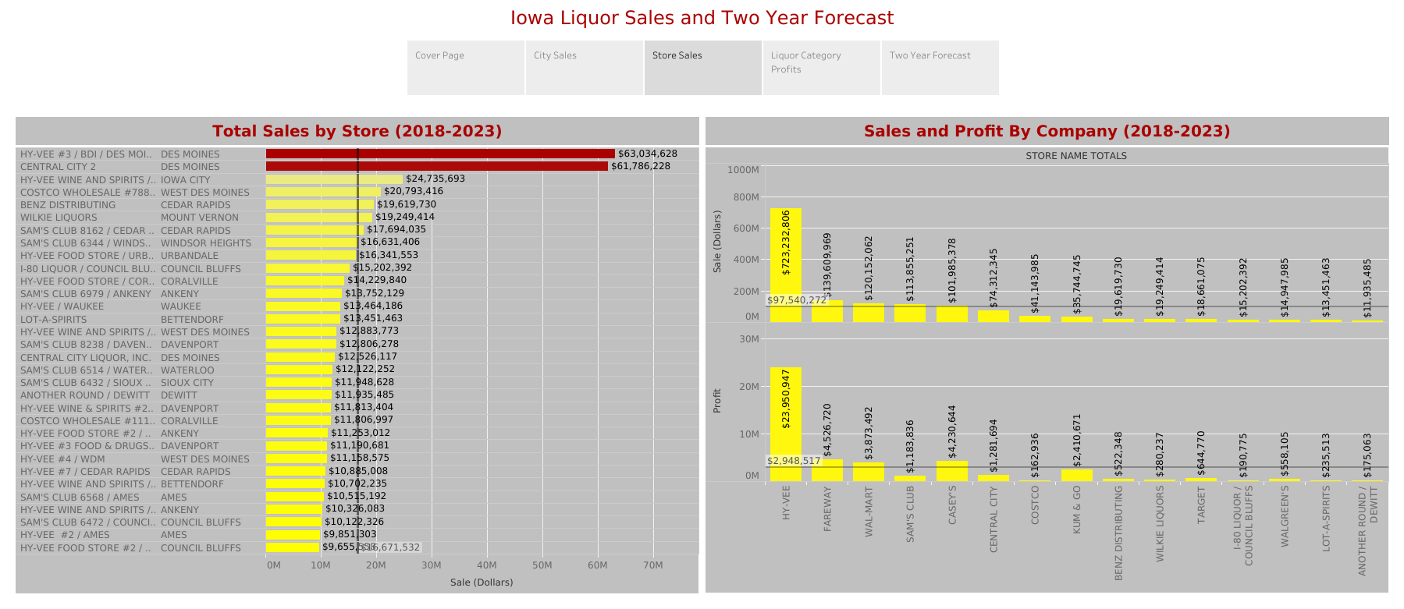

Slide 5
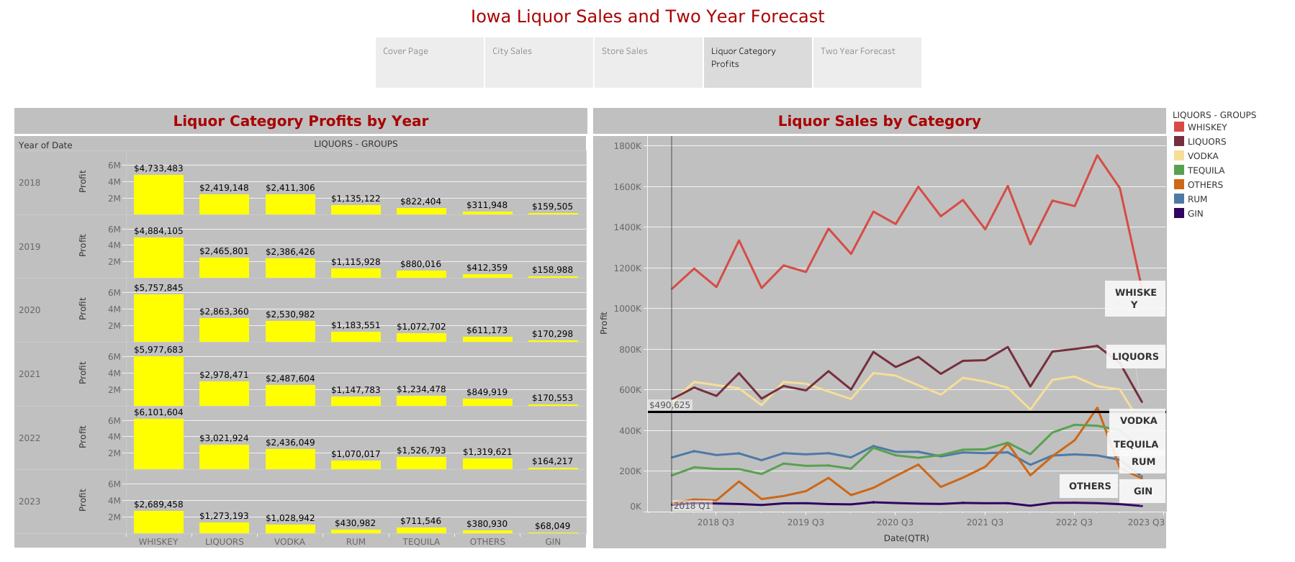

Slide 6
